Slide 1
Nmap

Slide 2
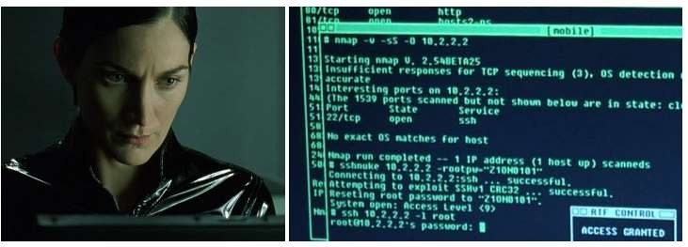
Nmap
Network Mapper - Utility used to identify assets and map them in a network.

Slide 3

Why Nmap
Perhaps I can ping sweep?
What if someone has a FW enabled?
How to know which IP’s are alive?
How does NMAP... Nmap?
There only
65535(PORTS) *2 (TCP &UDP)*24 ( if class C)
192.168.1.145
80
3128
8080
192.168.1.14
138
139
445
192.168.1.45
443
22
192.168.1.100
443

Slide 4


Nmap Discovery
nmap <options> <scan type> <target>
options
Host discover
-sn: Ping Scan - disable port scan
-Pn: Treat all hosts as online -- skip host discovery
-n/-R: Never do DNS resolution/Always resolve [default: sometimes]

Slide 5
Nmap Scanning techniques
-sP (Ping Sweep) – Performs ARP ping and ICMP echo request to determine system is alive.
-sS (SYN Scan) – Determines a system/port being alive by sending only SYN and waiting for SYN-ACK
-sT (TCP Scan) – Determines a system/port being alive by completing a 3way
handshake (SYN ; SYN+ACK ; ACK)
-sF (FIN Scan) – Determines a system/port being alive by sending FIN and waiting for an ACK.
-sU (UDP Scan) – Probes UDP detects system/port is alive when there is a
UDP response + ICMP packet Dest unreachable.

Slide 6
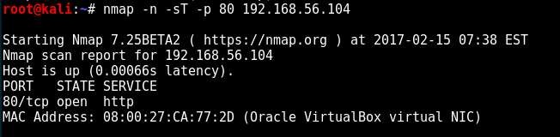
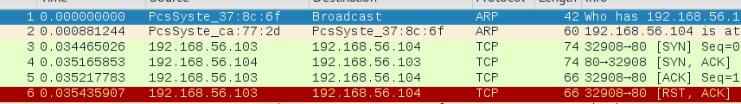
NMAP port “Status” - Open
Open - SYN reached the end system, victim responded with SYN+ACK and
Completes the handshake.
Nmap -n -sT -p 80 192.168.56.104

Slide 7
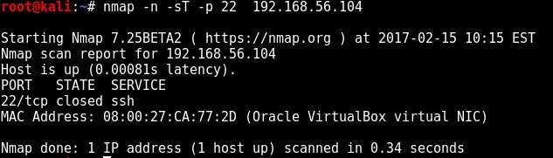
NMAP port “Status” - Closed
Closed - SYN reached the end system, responded with RST+ACK. System
is accessible and service is still not open on victim.
Nmap -n -sT -p 22 192.168.56.104

Slide 8
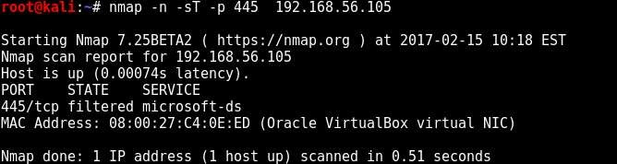
NMAP port “Status” - Filtered
Filtered – Observed when a port does not respond on repeated tries.
Nmap -n -sT -p 445 192.168.56.105

Slide 9

Why Service Enumeration?
Port is open,..
People run web server on 999 port!
Runs apache web service ?? like 33 % www servers run on it.
I need Banners and identify what they are!
I need Operating system type!
I need Vulns!

Slide 10
Nmap – service Version and Enumeration!
Nmap-services database is constantly updated with services, finger printing
and banners to identify remote ports and operating systems.
-sV - runs Nmap Script Engine (.nse files) to identify and
enumerate the service that has been detected earlier.
-sC – runs Nmap Script Engine (.nse files) to identify and enumerate the services and provide vulnerabilities identified. Optionally can use - -script option.

Slide 11
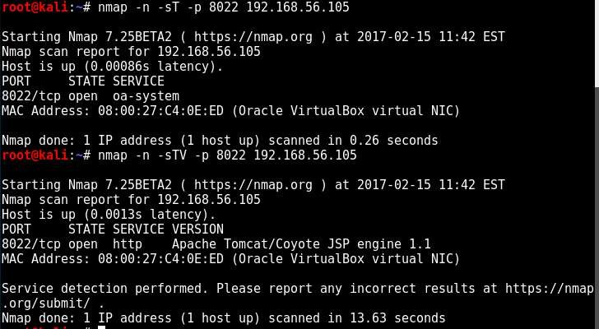
Nmap service Enumeration!
The Difference between the two in Action
Regular TCP scan
TCP scan with Version
-sT + -sV = -sTV

Slide 12
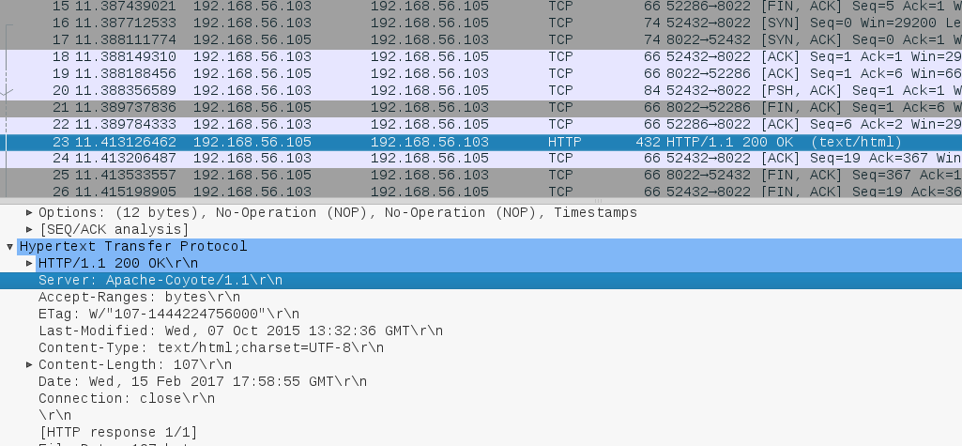
Nmap service Enumeration! –cont…
-sV under the hood!

Slide 13
NSE –What and Why?
Nmap Script Engine.
Sophisticated Version detection and OS detection.
Vulnerability detection.
Vulnerability Exploitation.

Slide 14
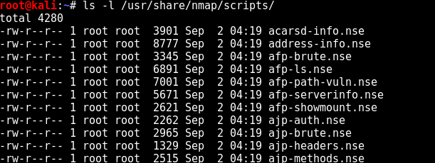
NSE – what? where?
-sC and –script uses NSE. There is a default set launched when no option is given. https://nmap.org/nsedoc/categories/default.html

Slide 15
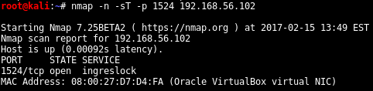
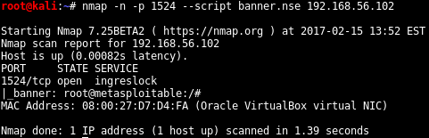
Nmap Enumeration technique
Notice how the service is not shell Even though Banner shows Shell

Slide 16
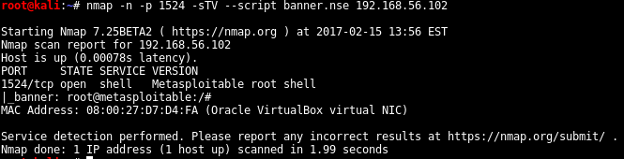
Nmap Enumeration technique
So you need to use –sTV along for Version grab

Slide 17
Nmap Scanning strategy
 | 192.168.56.102 | 192.168.56.103 | 192.168.56.104 | 192.168.56.105
 | TCP-80 | TCP-80 | TCP-80 | TCP-80
 | TCP- 445
 | TCP- 22 | TCP- 22
 | TCP -443 |  |  | TCP-443
 | TCP - 8080 |  | TCP-8080
 | TCP - 1524
 | TCP- 9999
Nmap --exclude 192.168.56.103 -sS –p 80 192.168.56.0/24 (sample- horizontal scan)
Nmap –sS –p1-6000,27017-27019 192.168.56.102 (sample – vertical scan)

Slide 18
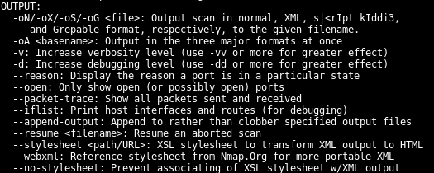
Nmap Output Formatting

Slide 19

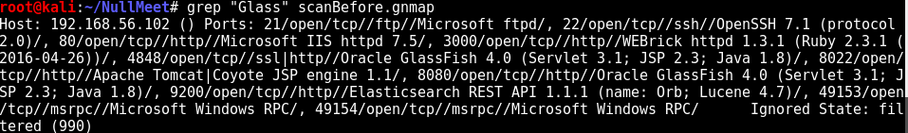
Nmap Output Formatting
Greppable Regular Text
XML

